Slide 1
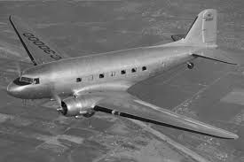
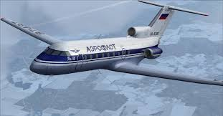
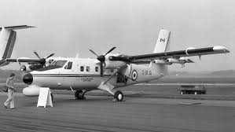
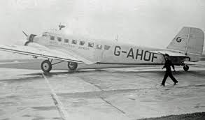
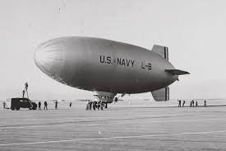
Analysis of Historical Airplane Crashes

Slide 2
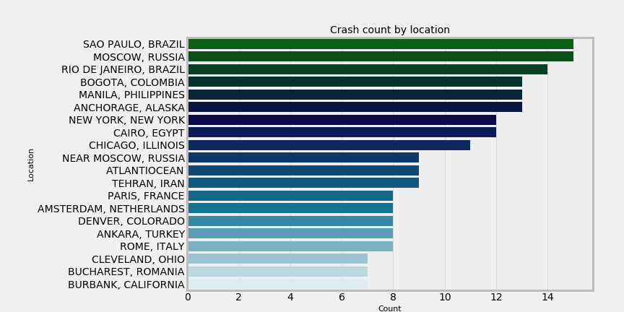
Crashes by Location
Does the crash location have anything to do with the actual crash cause, i.e. weather?

Slide 3
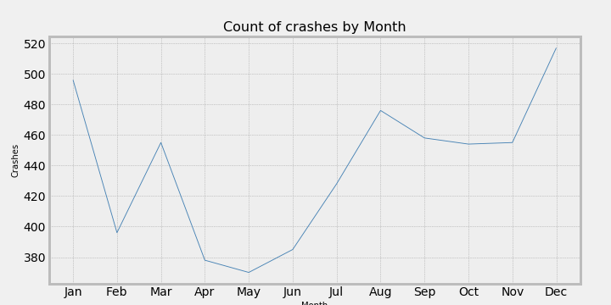
Crashes by month
Does the season effect the probability of a crash?
Most crashes tend to happen in the winter months.

Slide 4
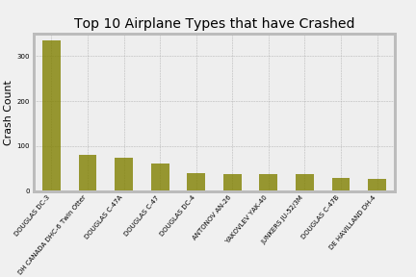
Top 10 Airplanes Types that have crashed
Are the top 10 airplane types commercial or military?
The Airplane types are

Slide 5
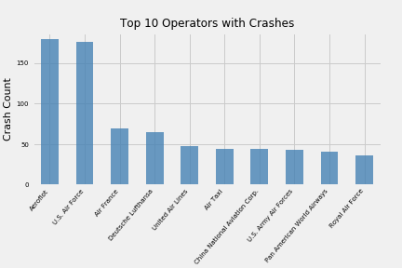
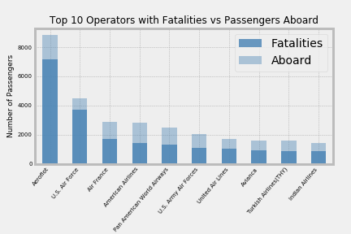
Operators with the highest number of crashes and Fatalities vs. Number of passengers aboard.
Only three of the top operators with the highest number of crashes are military.
Among the Operators with the most fatalities, most have a fairly good survival rate.
Aeroflot is one of the oldest airlines in the world, starting in 1923. During the Soviet Era (1922-1991), Aeroflot was the Soviet national airline and the largest airline in the world

Slide 6
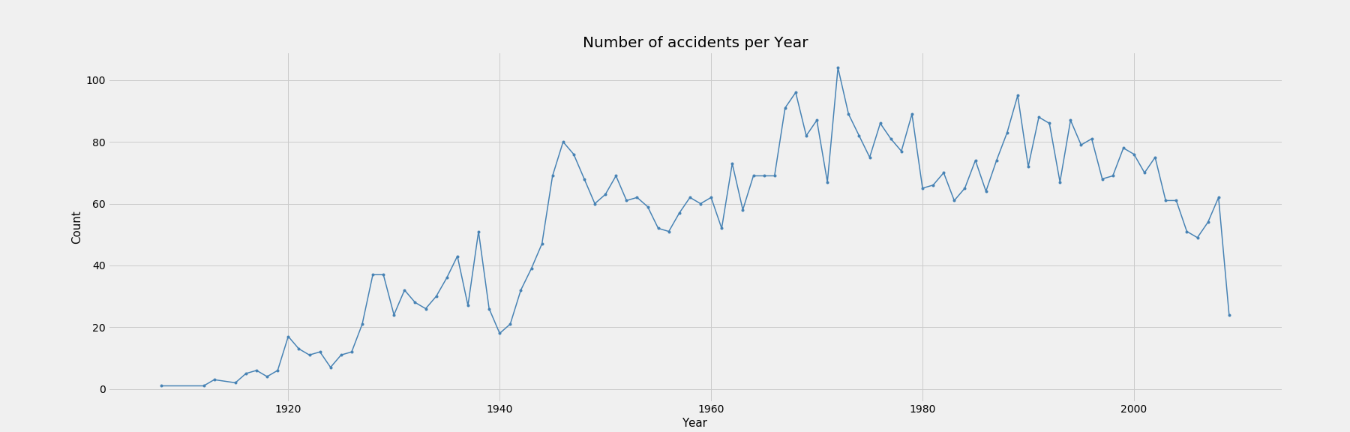
Number of Crashes per Year
What caused the sharp increase in the early 1940’s? This was during World War II
Highest number of crashes take place in the 1970’s, Vietnam war.
Earlier flights could only fly short distances due to fuel and weight limitations. This increased the chance of crashes because of the multiple takeoffs and landings.
Crashes seem to decline after the 1990’s, safety regulations put in place.

Slide 7
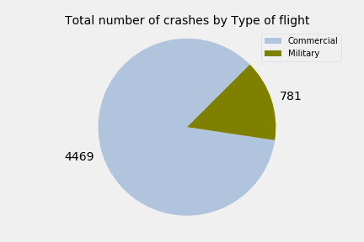
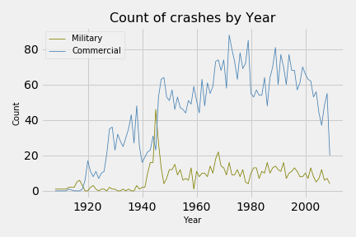
Military vs Commercial Crashes
Do Commercial and Military crashes follow the same pattern over time?
Other than the spike in the1940’s, the crashes do not necessarily follow the same pattern.
Total Number of Crashes Military vs Commercial
Crashes by year military vs. Commercial

Slide 8
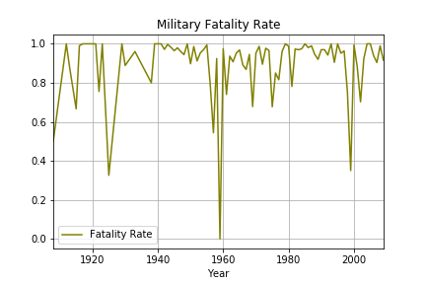
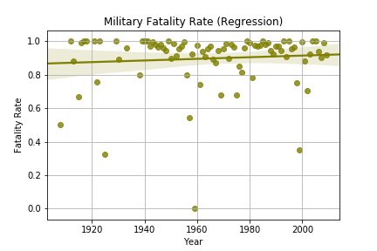
Military Fatality rate by year
The military fatality rate has a slight increase.
Fatality Rate percentage
Fatality Regression Model

Slide 9
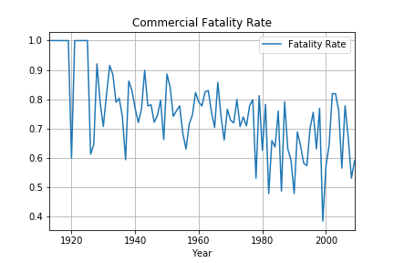
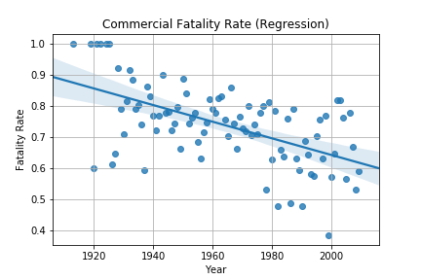
Commercial Fatality Rate by Year
You can see a clear downward trend.
Fatality rate Percentage
Fatality Regression Model

Slide 10
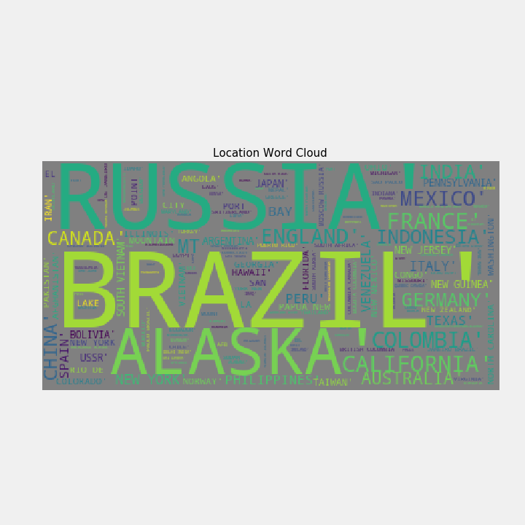
Dangerous Locations Word Cloud Think twice before traveling here ;)

